Slide 1

UFO Sightings in Arizona
Group 1 Final Project

Slide 2
Team Members
Connie Aceves
Angelica Rosario
Jordan Peterson
Katie Bernstein

Slide 3
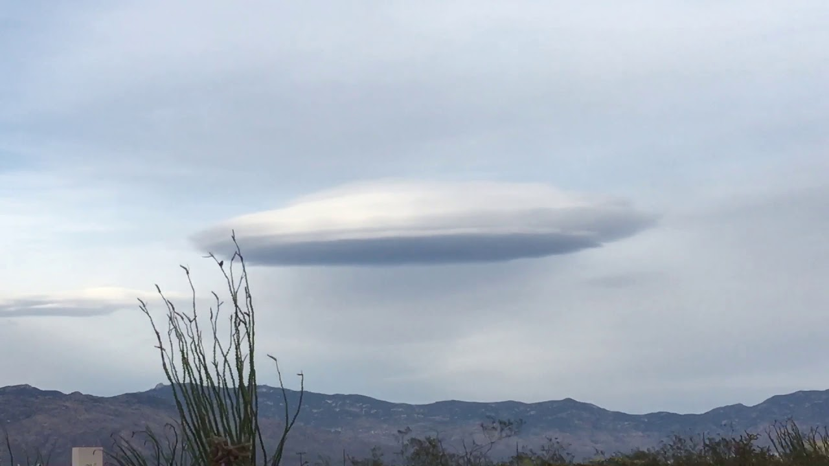
UFO Sightings in Arizona
Arizona has the 7th highest number of UFO sightings in the USA.
UFO sightings are a huge draw to tourism in Arizona and we wanted to use a data science approach to find out more about where these sightings might occur in the future.
As residents of Arizona, we are interested in where the sightings occur and how they might be influenced by the population increase in Arizona over the last 20 years.
There are UFO Conferences held in Arizona because of the high rate of sightings and interest.

Slide 4
UFO Sightings Dataset
Dataset Souce: Kaggle
https://www.kaggle.com/datasets/sadeghjalalian/ufo-sightings-in-usa
Data pulled from the National UFO Reporting Center (NUFORC)
This dataset contains the report content from the report itself including the time, location duration, and other attributes in both the raw form as it is recorded on the NUFORC site as well as a refined, standardized form that also contains lat/lon coordinates.

Slide 5
Additional Data Sources
City and Population Data Source: US Census Bureau: https://data.census.gov/cedsci/
World Population Review
https://worldpopulationreview.com/
United States Census data was utilized to determine proper city naming conventions along with gathering population data for each year of the project scope (2000 to 2022) to allow us to analyze the growth of the cities in relationship to the number of sightings in each city.

Slide 6
Project Questions:
Do UFO sightings in Arizona increase at the same rate as the city’s population growth in the state of Arizona?

Slide 7
Technology Used:
Dataset ETL/ERD:
Python and Jupyter Notebook
Machine Learning Model:
Google Colab – PySpark
Pandas
SKLearn Cluster
Plotly
Matplotlib
HV Plot
Database Creation
PGAdmin: Creating tables and joining tables
SQL Alchemy: Connection String to Python
QuickDBA: ERD Creation
Data Visualization
Power BI

Slide 8
Exploratory Data Analysis (Data Selection)
About UFO Dataset
www.kaggle.com/datasets/sadeghjalalian/ufo-sightings-in-usa
Downloaded the dataset from Kaggle. The Full text and geocoded UFO sighting reports from the National UFO Research Center (NUFORC). The National UFO Research Center (NUFORC) collects and serves over 100,000 reports of UFO sightings. The dataset contains data primarily from UFO sightings in the USA.
The following columns were found in the original dataset:
summary — The person who saw the UFO entered remarks. city — The location of the UFO sighting. state — The state was named for the city where it was discovered. date_time — The UFO sighting took place on this date and at this time. shape — The shape of the seen UFO. duration — In seconds, minutes the length of the sighting. | stats— time and date of sighting, including when entered. report_link — The url of actual report. text — The person who saw the UFO entered remarks. date posted — When the sighting was reported to the NUFORC, this was the date. city_latitude — The latitude of the sighting. city_longitude — The longitude of the sighting.
The dataset contains data primarily from UFO sightings in the United States. Total number of entries 136,939 and total number of columns 12. The following columns were found in the original dataset:

Slide 9
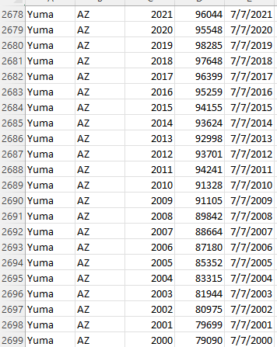
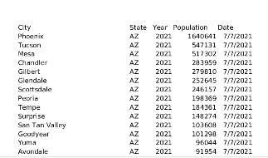
Exploratory Data Analysis (Dataset) - Connie
About Dataset: US Census Bureau
www. data.census.gov/cedsci/
City and Population by state
Clean_City_Polulation
About Dataset: World Population Review
www.worldpopulationreview.com/states/cities/Arizona
AZ_CityGrowth_YoY
city — name of city state Year 2000 to 2021 population date— data pulled | city state Year 2000 to 2021 population date
Arizona has 439 cities

Slide 10
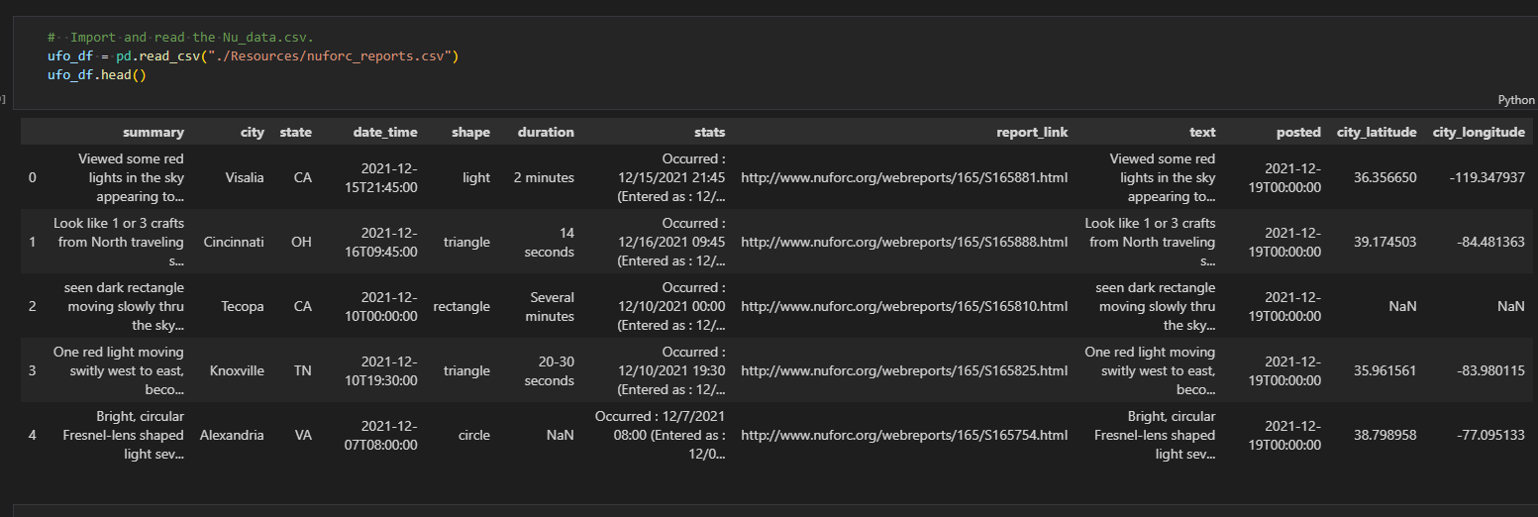
Preparing Data - Connie
Steps for Preparing Data
Data selection entails making good choices about which data will be used. Consider what data is available, what data is missing, and what data can be removed.
First examination of the UFO dataset, found missing data in random columns. There were sightings outside of the United States. A couple of the columns were redundant like summary and text. As well as some of the data in the download were not suitable to analyze like report_link
UFO dataset loaded into pandas dataframe: 1

Slide 11
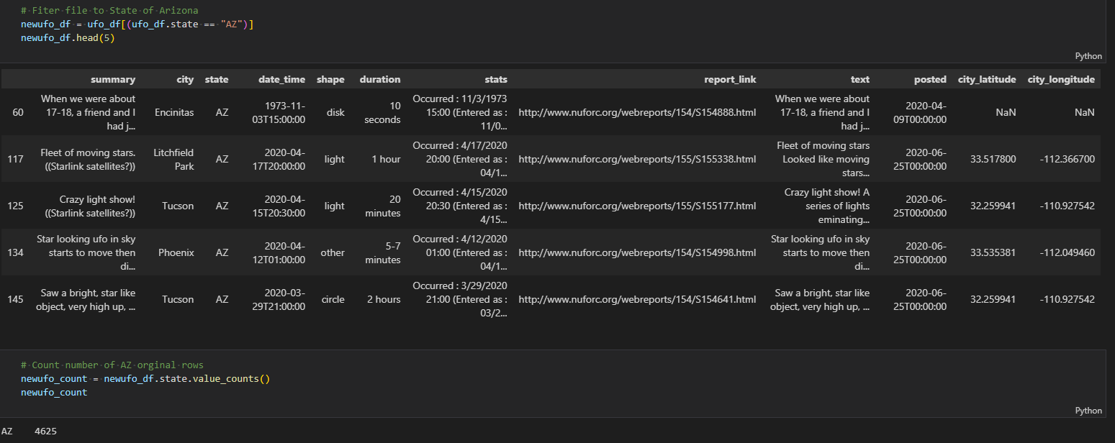
Preparing Data - Connie
Steps for Preparing Data
Data processing involves organizing the data by and since the premise of exercise is to analyze the sightings for Arizona decided to filter for the state which significantly reduced the data to 4625 entries.
One concern would there be enough data to do a proper analysis?
Pandas dataframe filtered for the state of Arizona:2

Slide 12
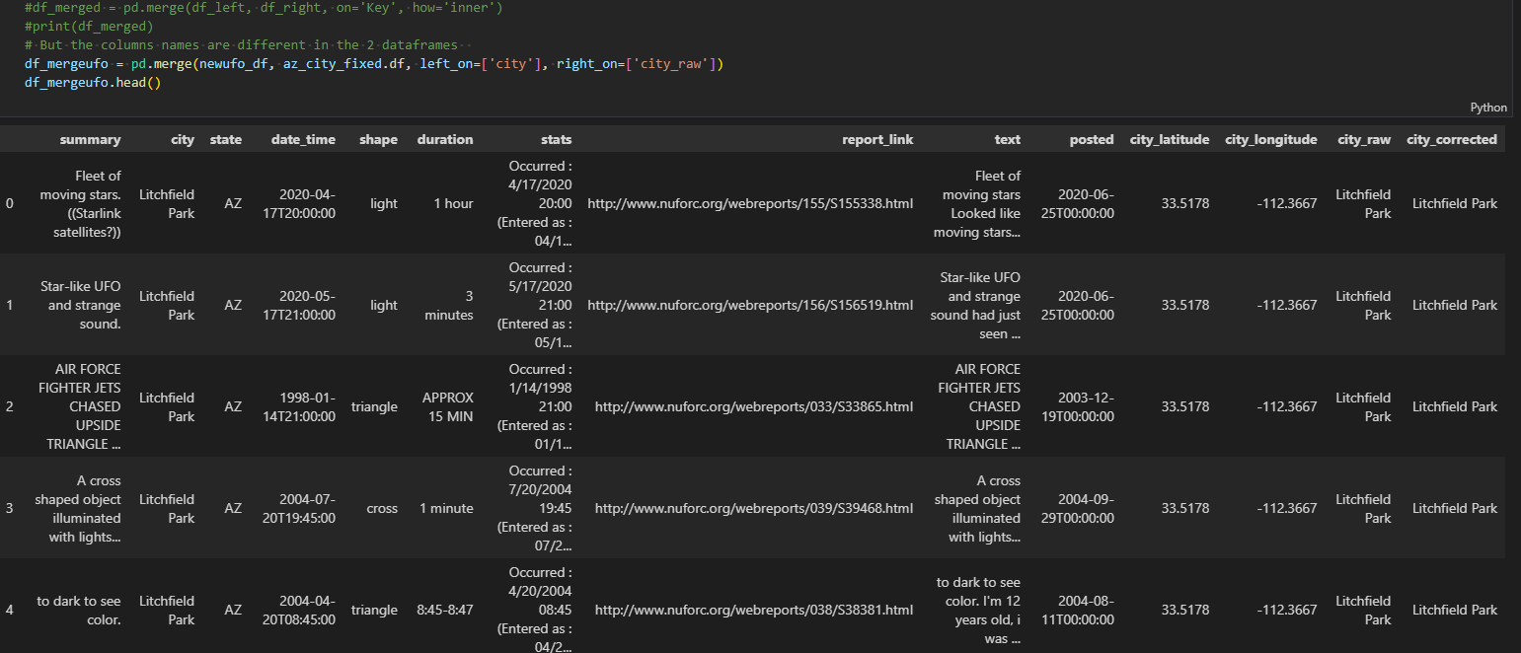
Preparing Data - Connie
Steps for Preparing Data
Data processing involves organizing the data by formatting, cleaning, and sampling it. In the UFO dataset the cities names had numerous misspellings.
Discovered in the UFO dataset for the “city” which contained references to neighborhoods instead of actual cities as well as misspelled city names.
Pandas loading Arizona city names to correct misspellings, left merge by city. 3

Slide 13
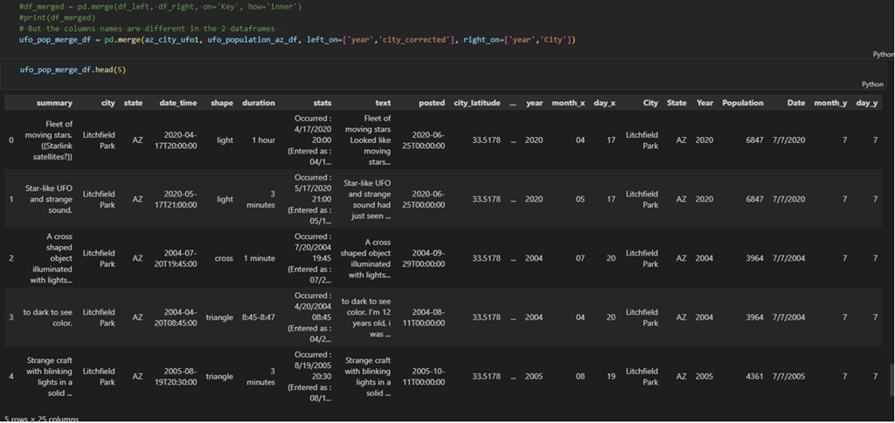
Preparing Data - Connie
Steps for Preparing Data
Decided by our team to download additional Arizona census data for the years 2000 to 2021 so additional entries would maintain UFO entries when merged with state population. Merging datasets allowed for the correction of city names.
Pandas loaded Arizona population for the years 2000 to 2021 with merge on left and right keys. 4

Slide 14
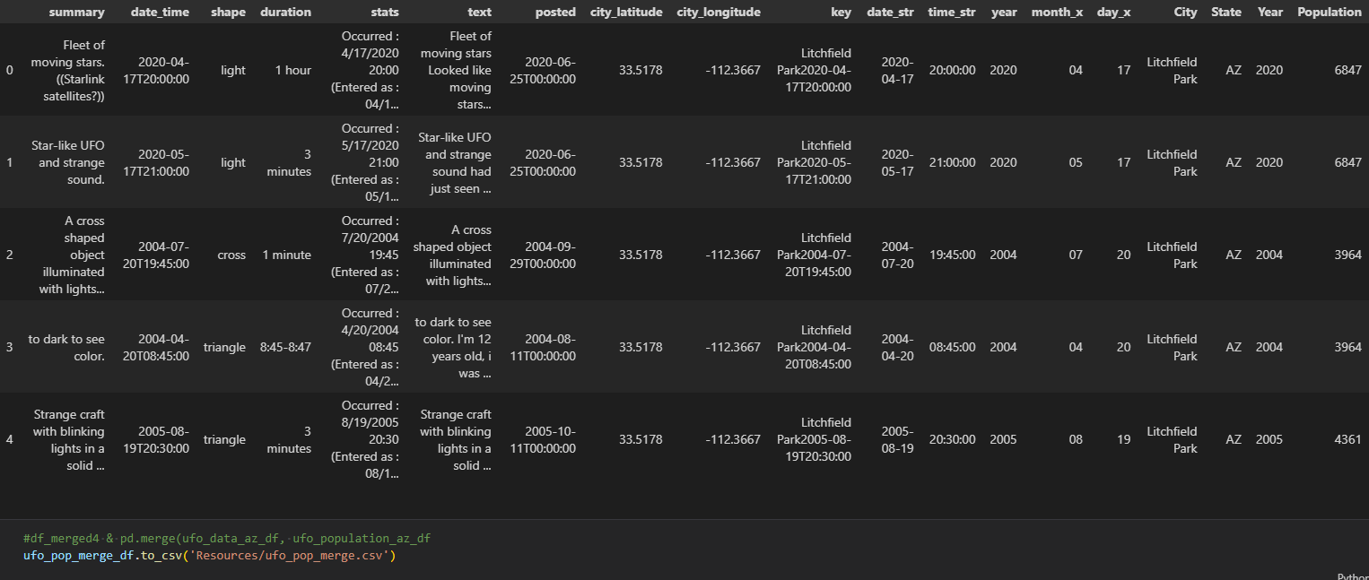
Preparing Data - Connie
Steps for Preparing Data
Preprocessing the UFO dataset to manage unnecessary columns, rows with null values, and mixed data types before using algorithms.
Data selection entails making good choices about which data will be used. Consider what data is available, what data is missing, and what data can be removed.
Data processing involves organizing the data by formatting, cleaning, and sampling it. In the UFO dataset the cities names had numerous misspellings.
Data transformation entailed loading csv files into python and processed so it could be exported to be used in analysis.
Data transformed and exported: ufo_pop_merge.csv

Slide 15
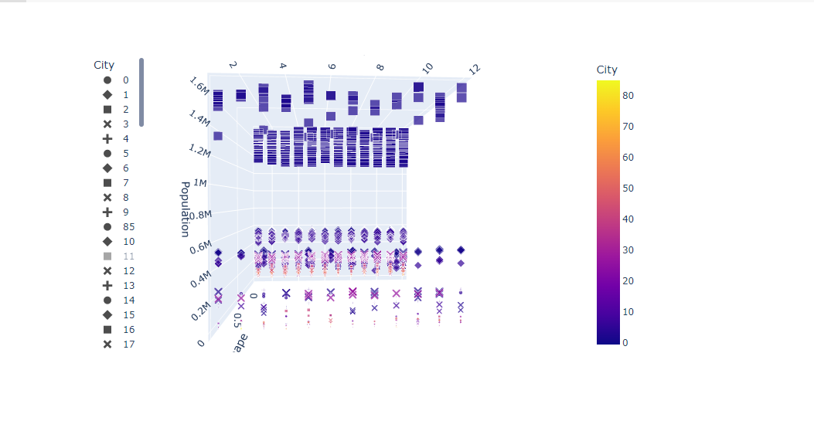
Machine Learning Model – Angelica
Our main question when running the ML model was if the number of UFO sightings increase or decrease based on a city’s population.
The 3D-Cluster model supports our hypothesis.
Cities with larger populations have more sightings throughout a given year.

Slide 16
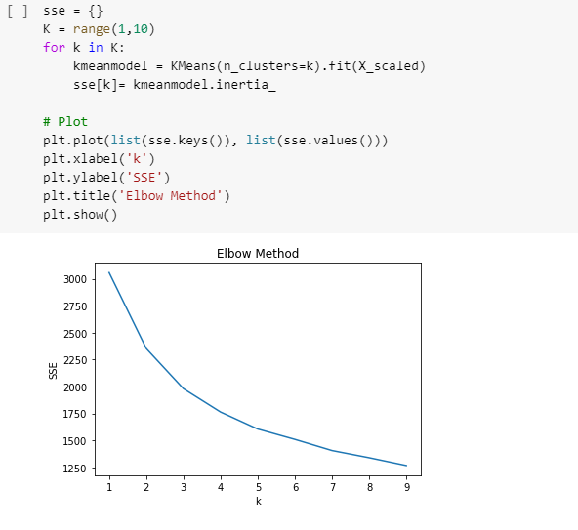
Machine Learning Model – Angelica
We performed K-Means Clustering to determine the optimal number of clusters to test our dataset.
Based on our ML unsupervised model, our elbow curve is around the 3 mark. K=3 meaning 3 clusters would be best.

Slide 17
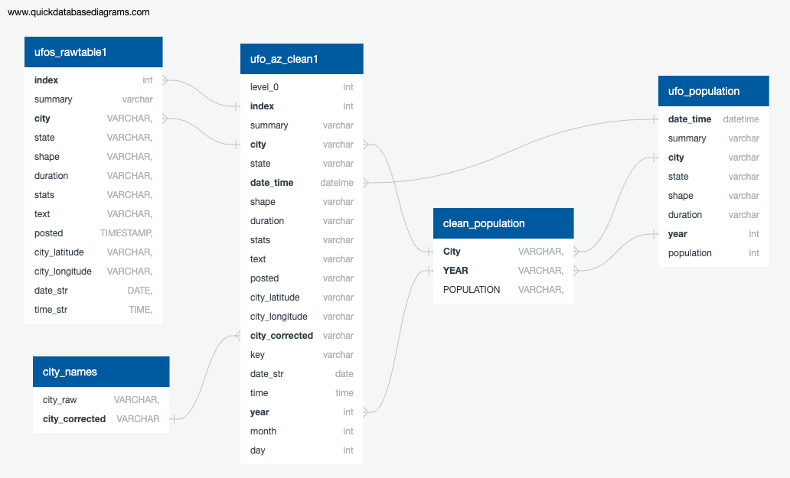
SQL Database Creation - Katie
Created a database to hold the raw data files and a SQL Alchemy connection was created to push the tables to Python. We then used the cleaning code that was used in the data preparation phase. Once completed, the cleaned data was then pushed backed to PGAdmin as a new table.
City and Population data was then loaded into SQL and joined to the clean data table. The final table (ufo_population) was then ready to be exported to use for machine learning.

Slide 18
SQL Database Application
The SQL database was a local copy for the purposes of this project – in a real world application, Amazon Web Services (AWS) could be used to host the database remotely which then all members of a team or group would connect to it via AWS.

Slide 19
Data Visualization - Jordan

Slide 20
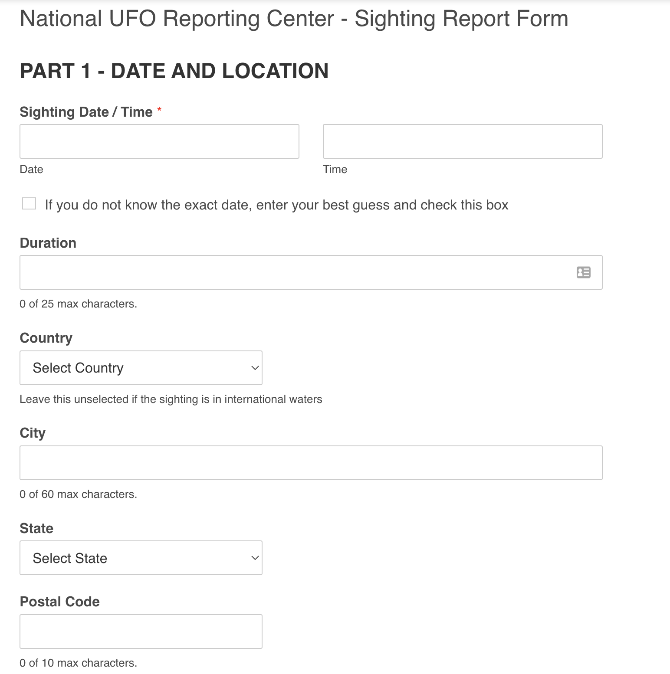
Recommendations for Future Analysis
National UFO Reporting Center Recommendations:
Less free form answers – more drop down options to reduce the amount of non-sense data or variability in the data.
Sighting Validation – new column or area of data where NUFORC can add their feedback that either approves or denies the sightings. Currently it is listed in the comment box.
Additional Datasets to include:
Weather Patterns
Locations of Government Testing Sites, Military Bases and other business locations that might effect the data.

Slide 21
Project Debrief – Lessons Learned
Select a dataset that has less free form data to help with the machine learning models.

